Slide 1
Web Design Assignment: Air Quality Monitoring Dashboard
Tun Myint Mo Khaung
202355678

Slide 2
Project Overview
Purpose
Monitor and analyze real-time air quality data.
Features
Real-time location-based search for air quality data.
Graphical representation of environmental factors.
Interactive navigation with multiple views (Daily, Monthly, Yearly).

Slide 3
Technology Stack
Languages
HTML, CSS, JavaScript.
Libraries & Frameworks
Chart.js for data visualization.
APIs (will be used)
Placeholder for future integration.

Slide 4


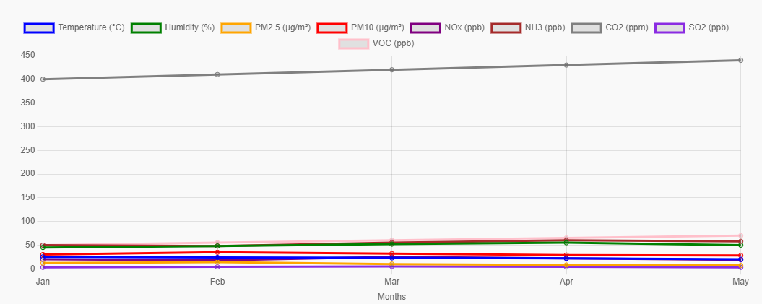
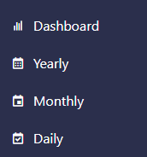
Key Features
Real-time Data Search
Location-based search bar for quick queries.
Dynamic Dashboard
Displays outdoor air quality status, pollutants, and key indicators.
Interactive Charts
Visualizes trends in temperature, humidity, PM2.5, and other pollutants.
Section Navigation
Seamlessly switch between dashboard, daily, monthly, and yearly views.

Slide 5
Data Visualization
Line Graphs
Comparison of pollutants (PM2.5, CO2, VOC, etc.) across time.
Air Quality Status Circle
Dynamic color changes based on air quality status.
Statistics Display
Detailed pollutant levels for specific areas.

Slide 6
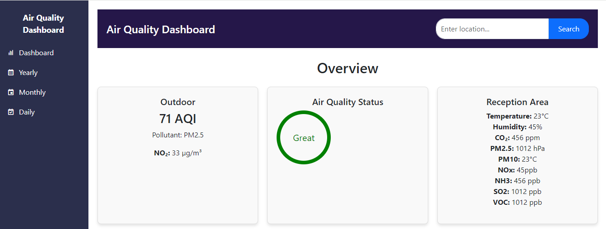
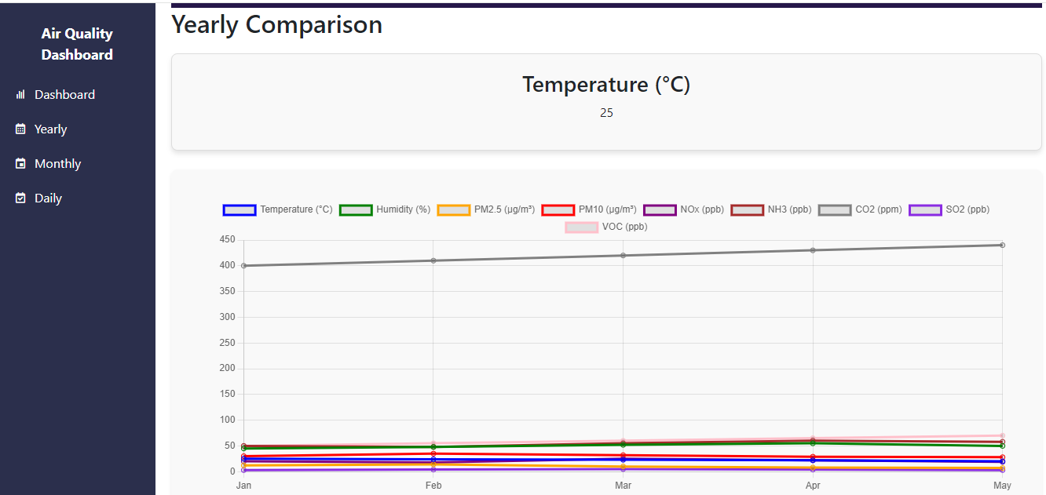
UI Design
Sidebar Navigation:
Compact and intuitive for quick access to sections.
Header with Search Functionality:
Enables real-time data lookup by location.
Cards for Data Visualization:
Displays AQI, pollutant levels, and key environmental stats.
Interactive Graphs:
Powered by Chart.js for responsive trend analysis

Slide 7
Future Improvements
Challenges
Dynamic chart.
Displaying real-time air quality updates
Expand Data Sources:
Integrate APIs for real-time global air quality data.
Enhanced Visuals:
Add animations and more intuitive user experiences.
Mobile Optimization:
Improve responsiveness for smaller screens.

Slide 8
https://tunmyintmokhaung.github.io/web_design/

